Slide 1
Assessment of microplastic abundance in beach sands and coastal surface waters
Implementation of a regional network for monitoring microplastics in marine-coastal environments in LAC.
Paola Sofía Obando Madera
INVEMAR, Santa Marta
Colombia

Slide 2


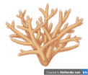
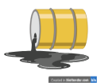

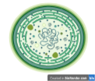
What is
Ocean acidification
Contamination Chemical
Microplastic Contamination
Eutrophication
FAN & Marine Toxins

Slide 3

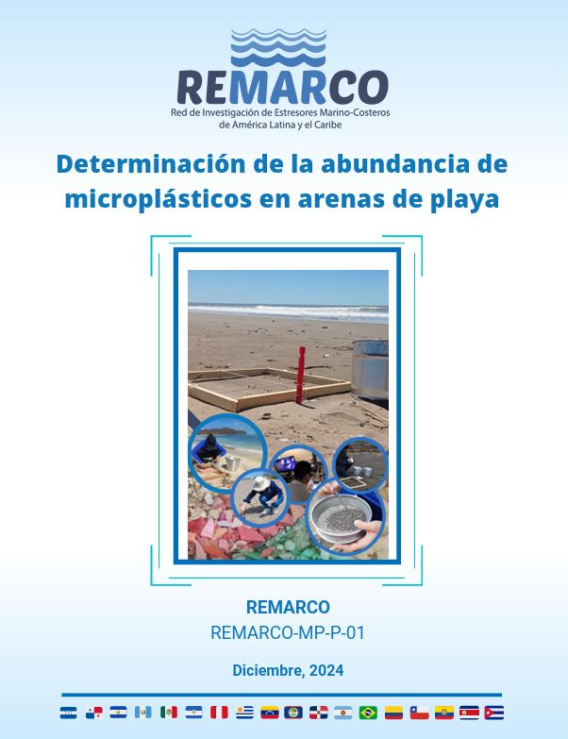
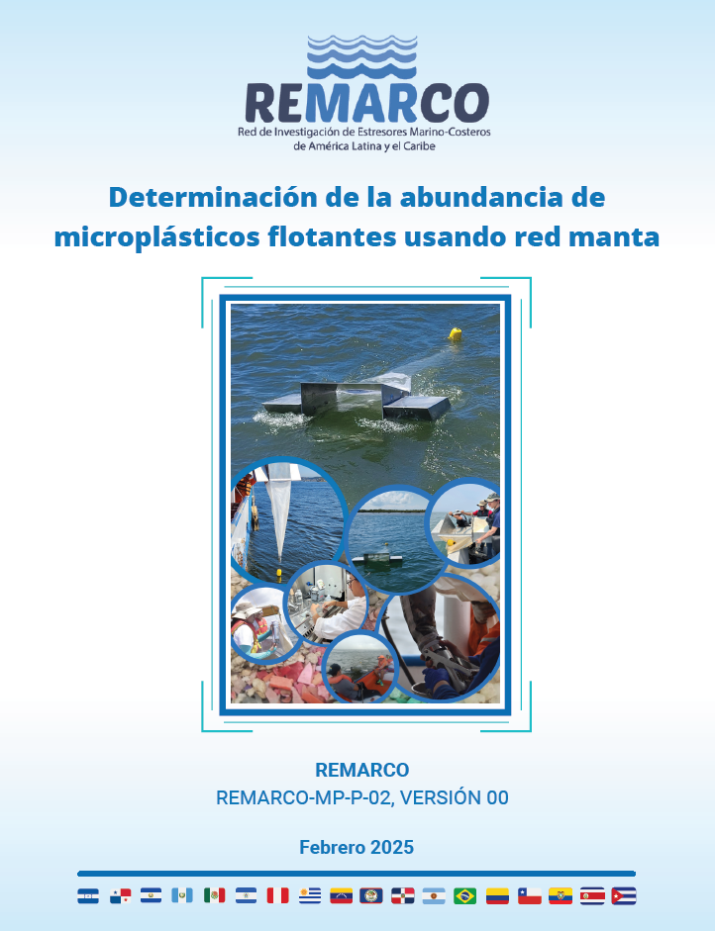
Two protocols for microplastic monitoring
Available in
REMARCO-MP-P-01, for assessing microplastics (300–5000 µm, density < 1,2 g/cm³) in beach sands with grain sizes < 2 mm.
REMARCO-MP-P-02, for evaluating floating microplastics (300–5000 µm, density < 1,2 g/cm³) in coastal surface waters using a manta net.

Slide 4
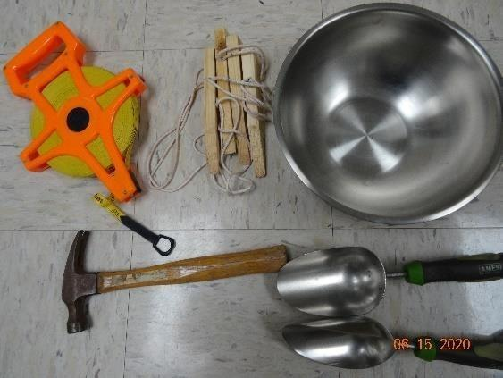
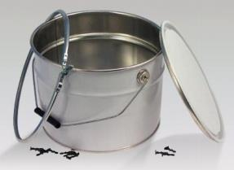
Materials, reagents and equipment
Matrix | In the field | In the laboratory
Sandy beaches | GPS (decimal degrees) 20 m measuring tape 50 × 50 cm quadrant Metal spoon or shovel Metal containers (≥1 L) | Filtered distilled water Oven or muffle furnace (for decontamination) Stainless steel sieves (5 mm,1 mm, 300 µm) Saturated NaCl solution (1,2 g cm-³) Vacuum filtration system Filtered H₂O₂ 30% (if needed) Stereomicroscope (40x) FTIR-ATR or Raman
Surface waters | GPS (decimal degrees) Manta net (300 µm mesh) Flowmeter Digital Timer Submersible pump or bucket Glass/metal containers (≥1 L) | Filtered distilled water & 70% alcohol Stainless steel sieves (5 mm, 1 mm, 300 µm) Filtered Saturated NaCl solution (1,2 g cm⁻³) Vacuum filtration system Filtered H₂O₂ 30% (if needed) Stereomicroscope (40x) FTIR-ATR or Raman

Slide 5
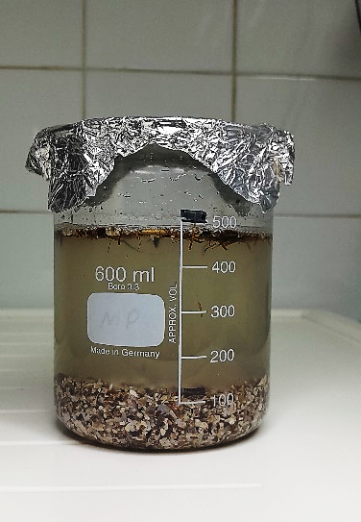
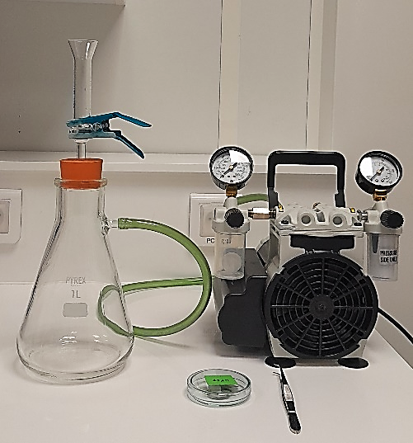
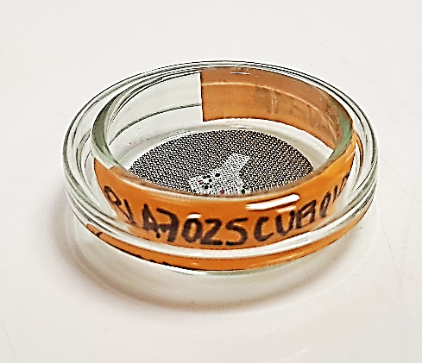
REMARCO-MP-P-01 Abundance of MP particles in beach sands
Applicable for plastic particles ranging between 300 μm and 5 mm
MP particles, 300 µm - 5 mm, density < 1.2 g cm⁻³, in surface (1 cm depth) beach sands (<2 mm)
Two size fractions: >300 μm - <1 mm and >1 mm - < 5 mm
The analysis of MPs includes:
sample collection
dry sieving techniques
density separation (NaCl solution, 1.2 g cm⁻³)
organic matter removal (H₂O₂, 30 %)
counting of primary, secondary and total MPs under a dissecting microscope

Slide 6
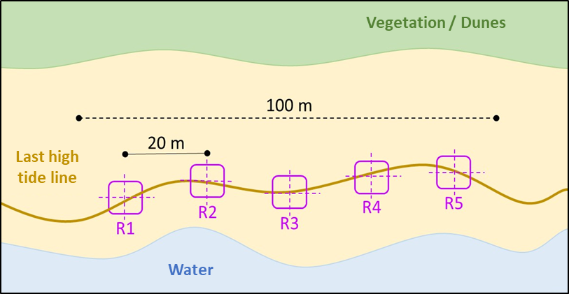
Selection of the sampling site
The distribution and abundance of MPs are influenced by seasonal changes, natural events, and anthropogenic activities
Consider land use (natural, rural or urban) of the surroundings
Proximity of wastewater discharges, storm drains, tourism and fishing activities along the coastline
Meteorological conditions (e.g., waves, wind speed, or storm events on previous days)
Collection of sand samples
mark the sample collection area
100 m-long transect parallel to the shoreline
above high tide line of the daily tidal cycle
place a 50 x 50 cm, 1 cm thick quadrat
(4 sections, 25 x 25 cm), every 20 m along the transect
sample after high tide
5 samples to be treated as replicates (R1 to R5)
the section of the quadrat to be chosen randomly
before sampling activities

Slide 7
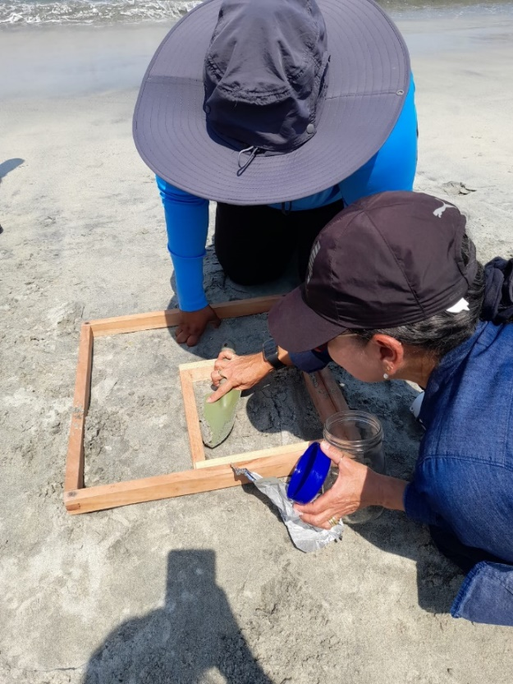
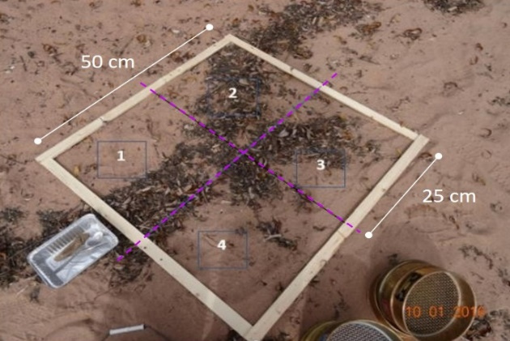
REMARCO-MP-P-01 Abundance of MP particles in beach sands

Slide 8
Procedure for assessment of microplastic abundance in beach sand
Surface sand sampling
(5 replicates of 25 x 25 cm)
REMARCO-MP-P-01 Abundance of MP particles in beach sands
Dry the samples at ≤ 50 °C (record dry weight of samples)
Dry sieving separation, using cascade sieves of 300 µm, 1 mm, and 5 mm (15 min)
300 µm ≤ fraction < 1 mm
1 mm ≤ fraction < 5 mm
Discard fraction > 5 mm
Density separation using saturated NaCl solution (1.2 g/cm³) (30 min shaking; settle overnight)
Density separation using saturated NaCl solution (1.2 g/cm³) (30 min shaking; settle overnight)
Supernatant filtration (250 µm metal filter)
Supernatant filtration (1 mm metal filter)
Organic digestion (H₂O₂ 30–35%)
Identification and counting of MPs under stereomicroscope. MP confirmation via FTIR-ATR or Raman
Record MP abundance (Annex IV)

Slide 9
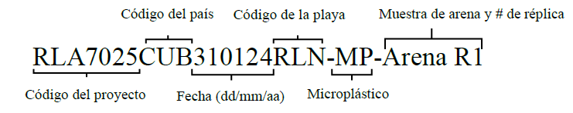
Sample identification and microplastic abundance report
REMARCO-MP-P-01 Abundance of MP particles in beach sands
Country code
Beach code
Sand sample and # replicate
Project code
Date (dd/mm/yy)
Microplastic
Record the abundance values by type of microplastic (primary or secondary) and total abundance (MP m⁻² and MP kg⁻¹ dry weight) for the analyzed fractions in each replicate, using the template in Annex IV.
Microplastic abundance (MPs $\text{m}\text{⁻²}$) $=\frac{\text{Total} \text{number} \text{of} \text{microplastics} \text{on} \text{the} \text{filter}}{\text{Sample} \text{area} \text{analyzed}\text{ (0.0625 }\text{m}\text{²)}}$
Microplastic abundance (MPs kg⁻¹) $=\frac{\text{Total} \text{number} \text{of} \text{microplastics} \text{on} \text{the} \text{filter}}{\text{Dry} \text{weight} \text{of} \text{the} \text{sample}\text{ (}\text{kg}\text{)} }$

Slide 10
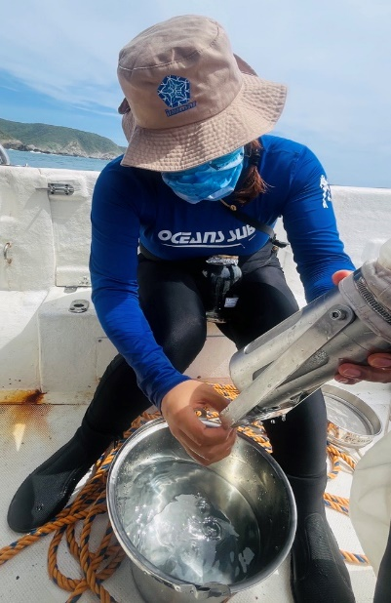
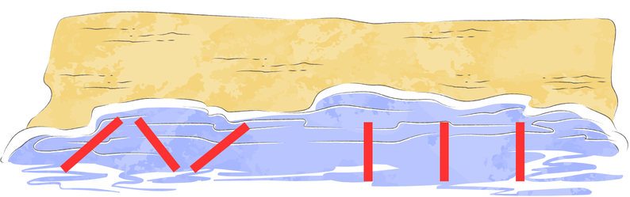
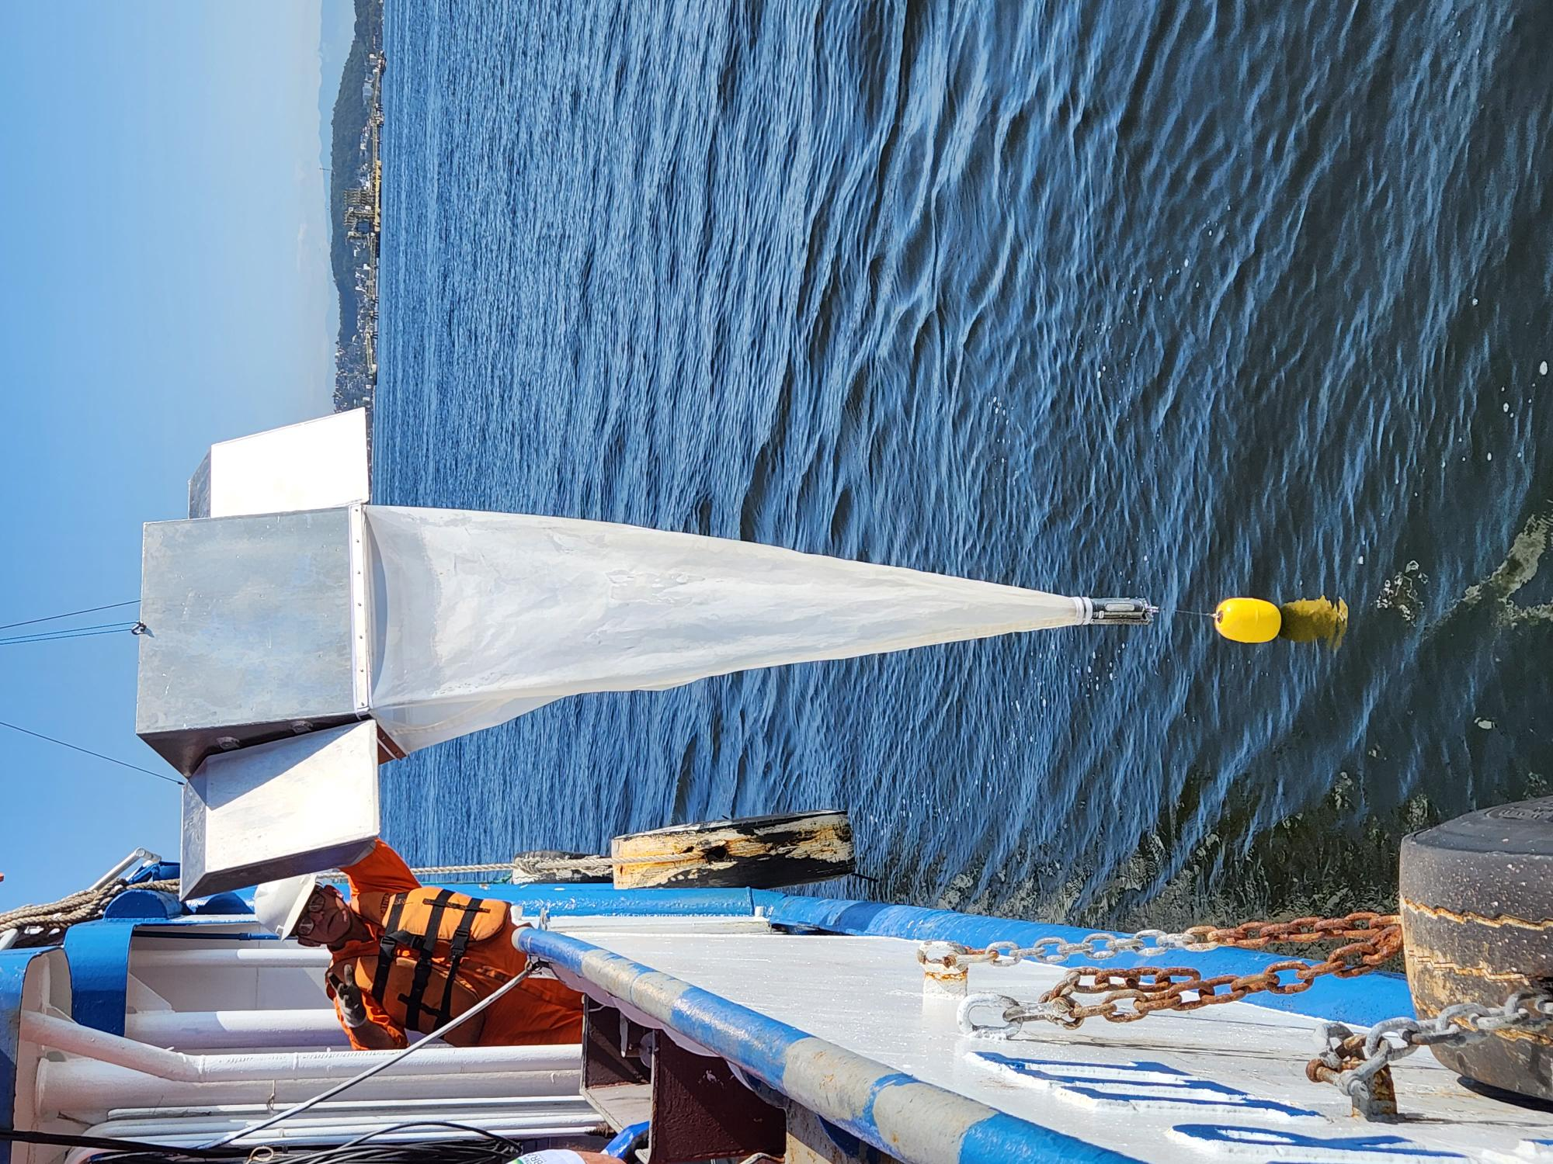
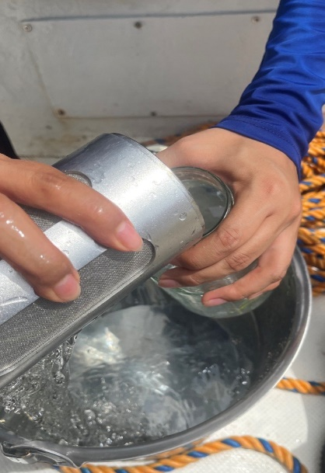
Sampling – MPs in surface waters
Navigate at 1–3 knots to stabilize the net, avoid tearing, and reduce turbulence.
Position the flowmeter at the center of the net mouth and record its initial reading before deployment. Once the tow is done, record the final reading.
REMARCO-MP-P-02, for evaluating floating microplastics in Surface Waters used manta net
The procedure involves collecting three replicate seawater samples using a manta net. Three replicate manta net tows (5–20 min each) are performed at each sampling site, with tow routes based on local conditions (e.g., geomorphology, bathymetry). Recommended patterns include zigzag (for narrow areas) or parallel to the coast. Sampling areas should be predetermined to avoid bias.
Log the time, GPS and flowmeter valuescoordinates at the start and end of sampling

Slide 11
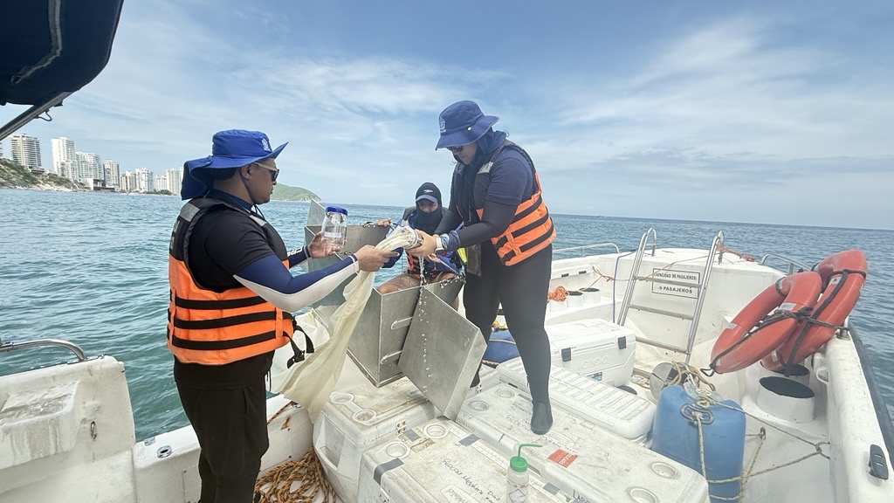
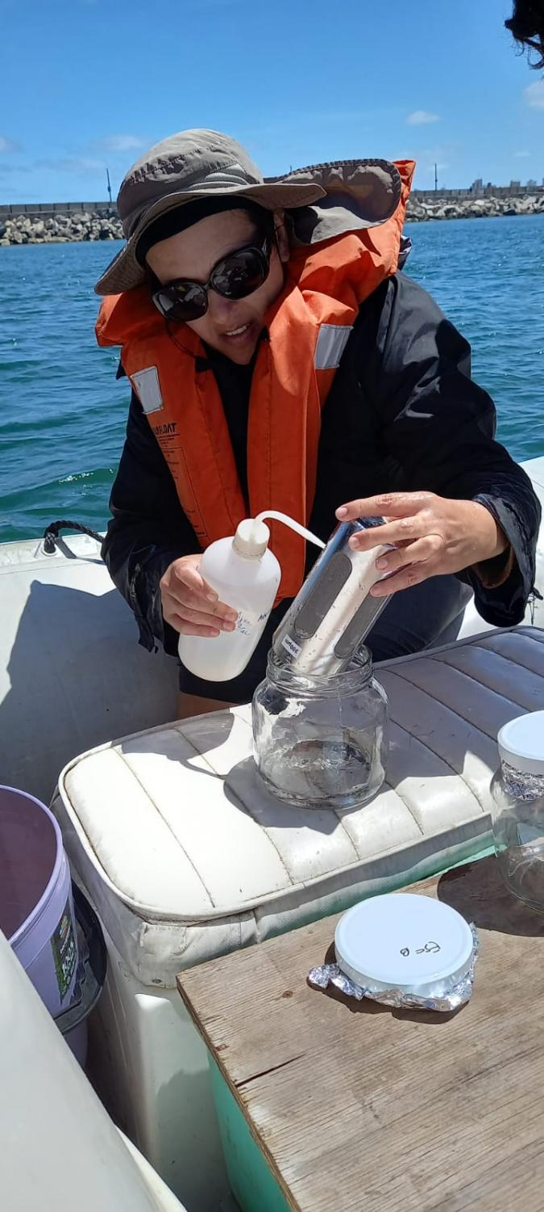
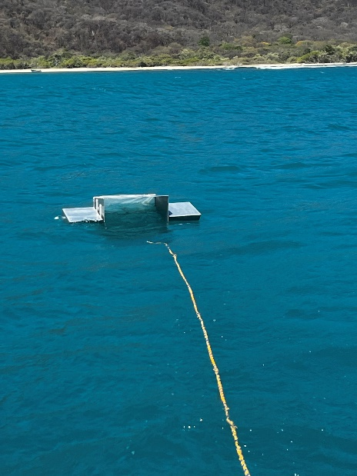
REMARCO-MP-P-02, for evaluating floating microplastics in Surface Waters used manta net

Slide 12
Procedure for assessment of microplastic in coastal surface waters (manta net)
Surface water sampling using manta net (3 replicates; 5-25 min; 1-3 knots)
REMARCO-MP-P-02, for evaluating floating microplastics in Surface Waters used manta net
Wet sieving using a cascade of sieves: 5mm – 1mm - 300 µm
300 µm ≤ fraction < 1 mm
1 mm ≤ fraction < 5 mm
Discard fraction > 5 mm
Density separation using saturated NaCl solution (1,2 g/cm³) (30 min shaking; settle overnight)
Record MP abundance (Annex IV)
Organic digestion (H₂O₂ 30–35%)
High organic matter content?
Yes
MP confirmation via FTIR-ATR or Raman
Identification and counting of MPs under stereomicroscope
No

Slide 13
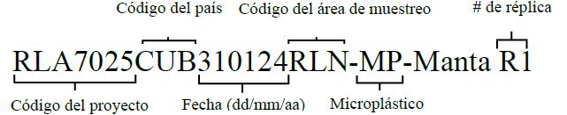
Sample identification and microplastic abundance report
REMARCO-MP-P-02, for evaluating floating microplastics in Surface Waters used manta net
Country code
Sampling area code
# replicate
Project code
Date (dd/mm/yy)
Microplastic
Microplastic abundance (MPs $\text{m}\text{⁻}\text{3}$) $=\frac{\text{Total} \text{number} \text{of} \text{microplastics} \text{on} \text{the} \text{filter}}{\text{Volume} \text{of} \text{filtered} \text{water} \text{(}\text{m}\text{3}\text{)}}$
Record the abundance values by type of microplastic (primary or secondary) and total abundance (MP m⁻³) for the analyzed fractions in each replicate, using the template in Annex IV of the protocol REMARCO-MP-P-02.

Slide 14
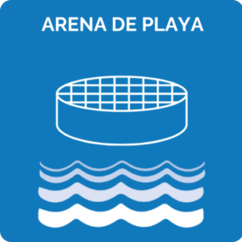

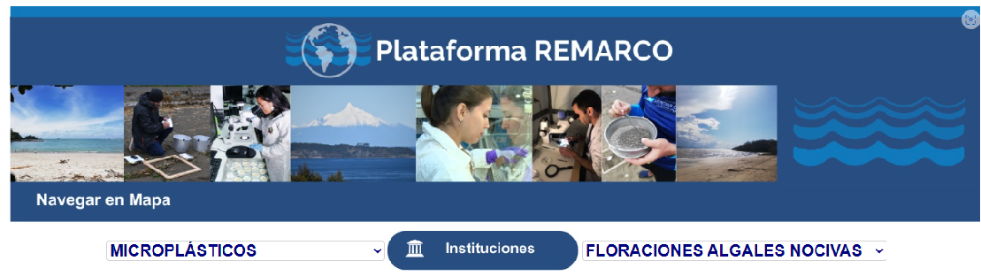

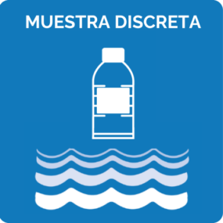
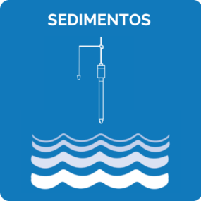
Microplastic Abundance Report & Indicators
N° of total particulate matter of MPs/ m²
N° of total particulate matter of MPs/ Kg p.s
N° of primary MPs / m²
N° of primary MPs / Kg p.s
N° of secondary MPs / m²
N° of secondary MPs / Kg p.s
N° of total particulate of MPs/ m³
N° of primary MPs/ m³
N° of secondary MPs / m³
(1-5 mm) ; (0,3-1 mm)
https://remarco.org/plataforma-remarco/

Slide 15
References
Available in
Alonso Hernández, C.M., Barrientos, E.E.,Carrasco Palma, D., Costa Muniz, M., Díaz-Jaramillo, M., González, M., Helguera Pedraza, Y.,Lozoya Azcárate, J.P., Obando-Madera, P.S.,Ontiveros Cuadras, J.F., Purca Cuicapusa, S.,Ramírez Álvarez, N., Ríos Mendoza, L.M., Ruiz-Fernández, A.C., y Saldarriaga-Vélez, J.F. (2024).Determinación de la abundancia de microplásticos en arenas de playa. Red de Investigación de Estresores Marinos – Costeros en Latinoamérica y El Caribe – REMARCO. 18 pp. https://remarco.org/manual-de-procedimientos-tecnicos-contaminacion-por-microplasticos/
Alonso Hernández, C.M., Carrasco Palma, D., de Sa Felizardo, J.P., Díaz-Jaramillo, M., DomínguezCazco, G.A., González, M., Helguera Pedraza, Y.,Obando-Madera, P.S., Ontiveros Cuadras, J.F.,Purca Cuicapusa, S., Ríos Mendoza, L.M., Ruiz-Fernández, A.C., Saldarriaga-Vélez, J.F., y Teixeirade Mello, F. (2025). Determinación de la abundancia de microplásticos flotantes usando red manta. Red de Investigación de Estresores Marinos - Costeros en Latinoamérica y El Caribe– REMARCO. 21 pp. https://remarco.org/manual-de-procedimientos-tecnicos-contaminacion-por-microplasticos/

Slide 16
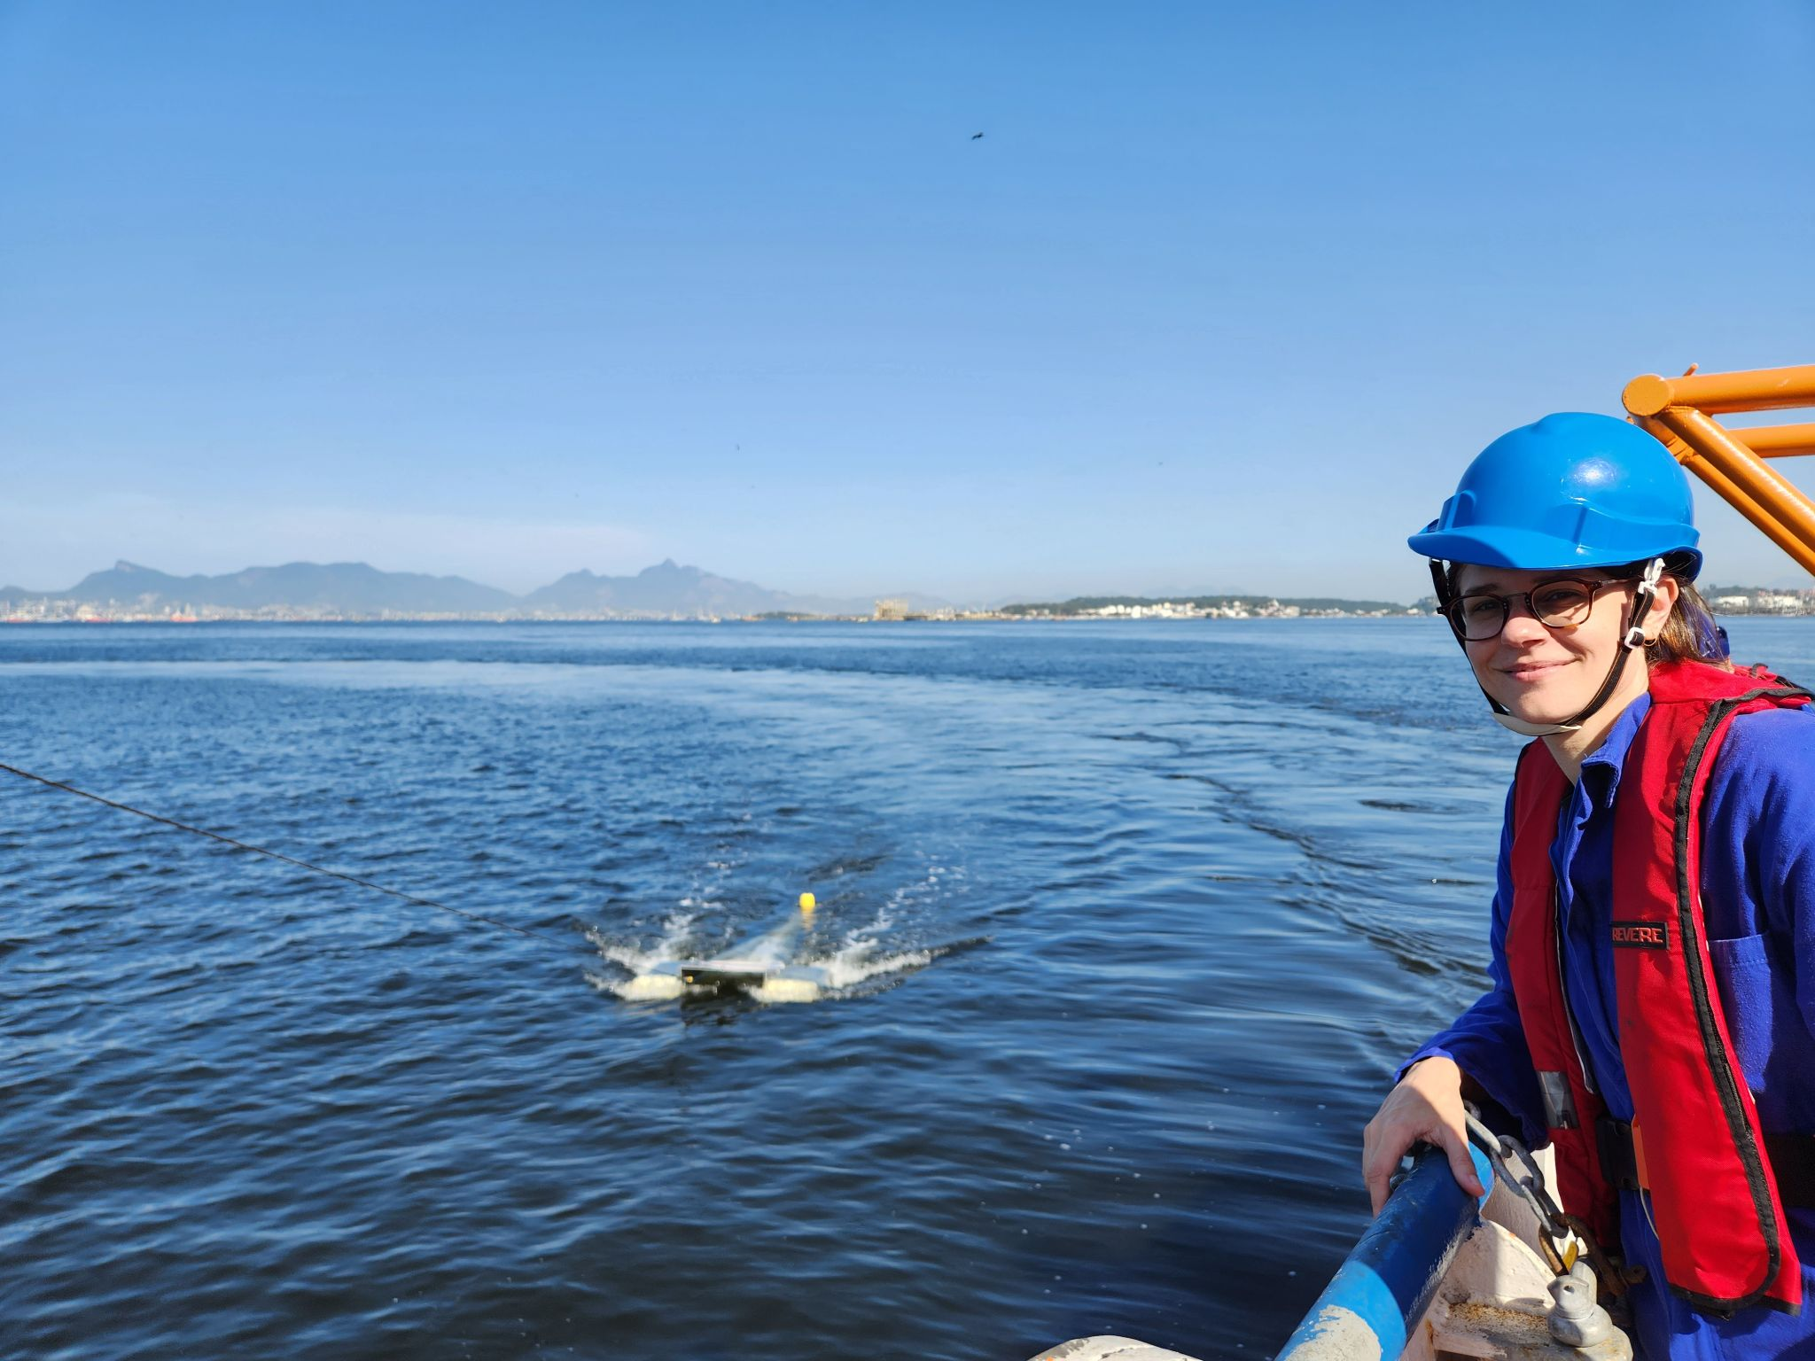
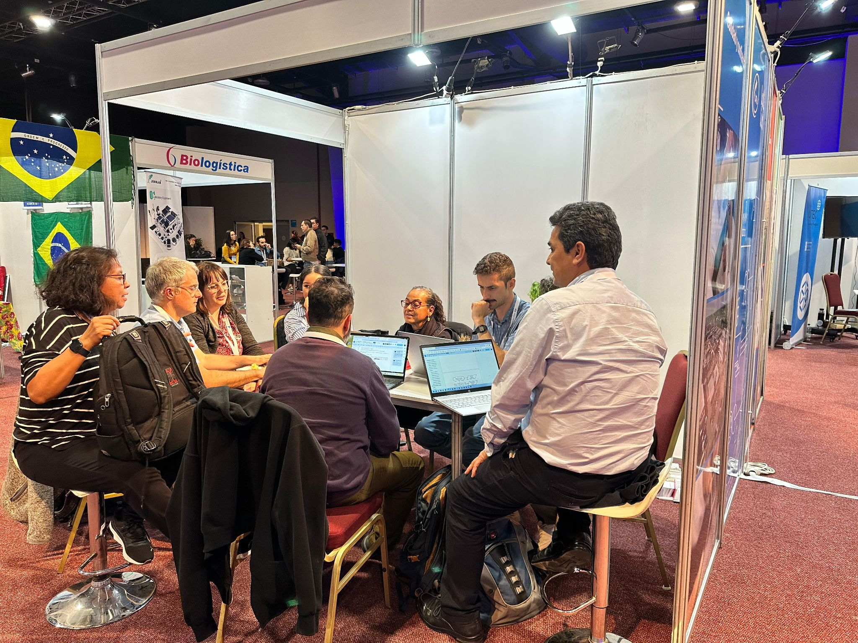
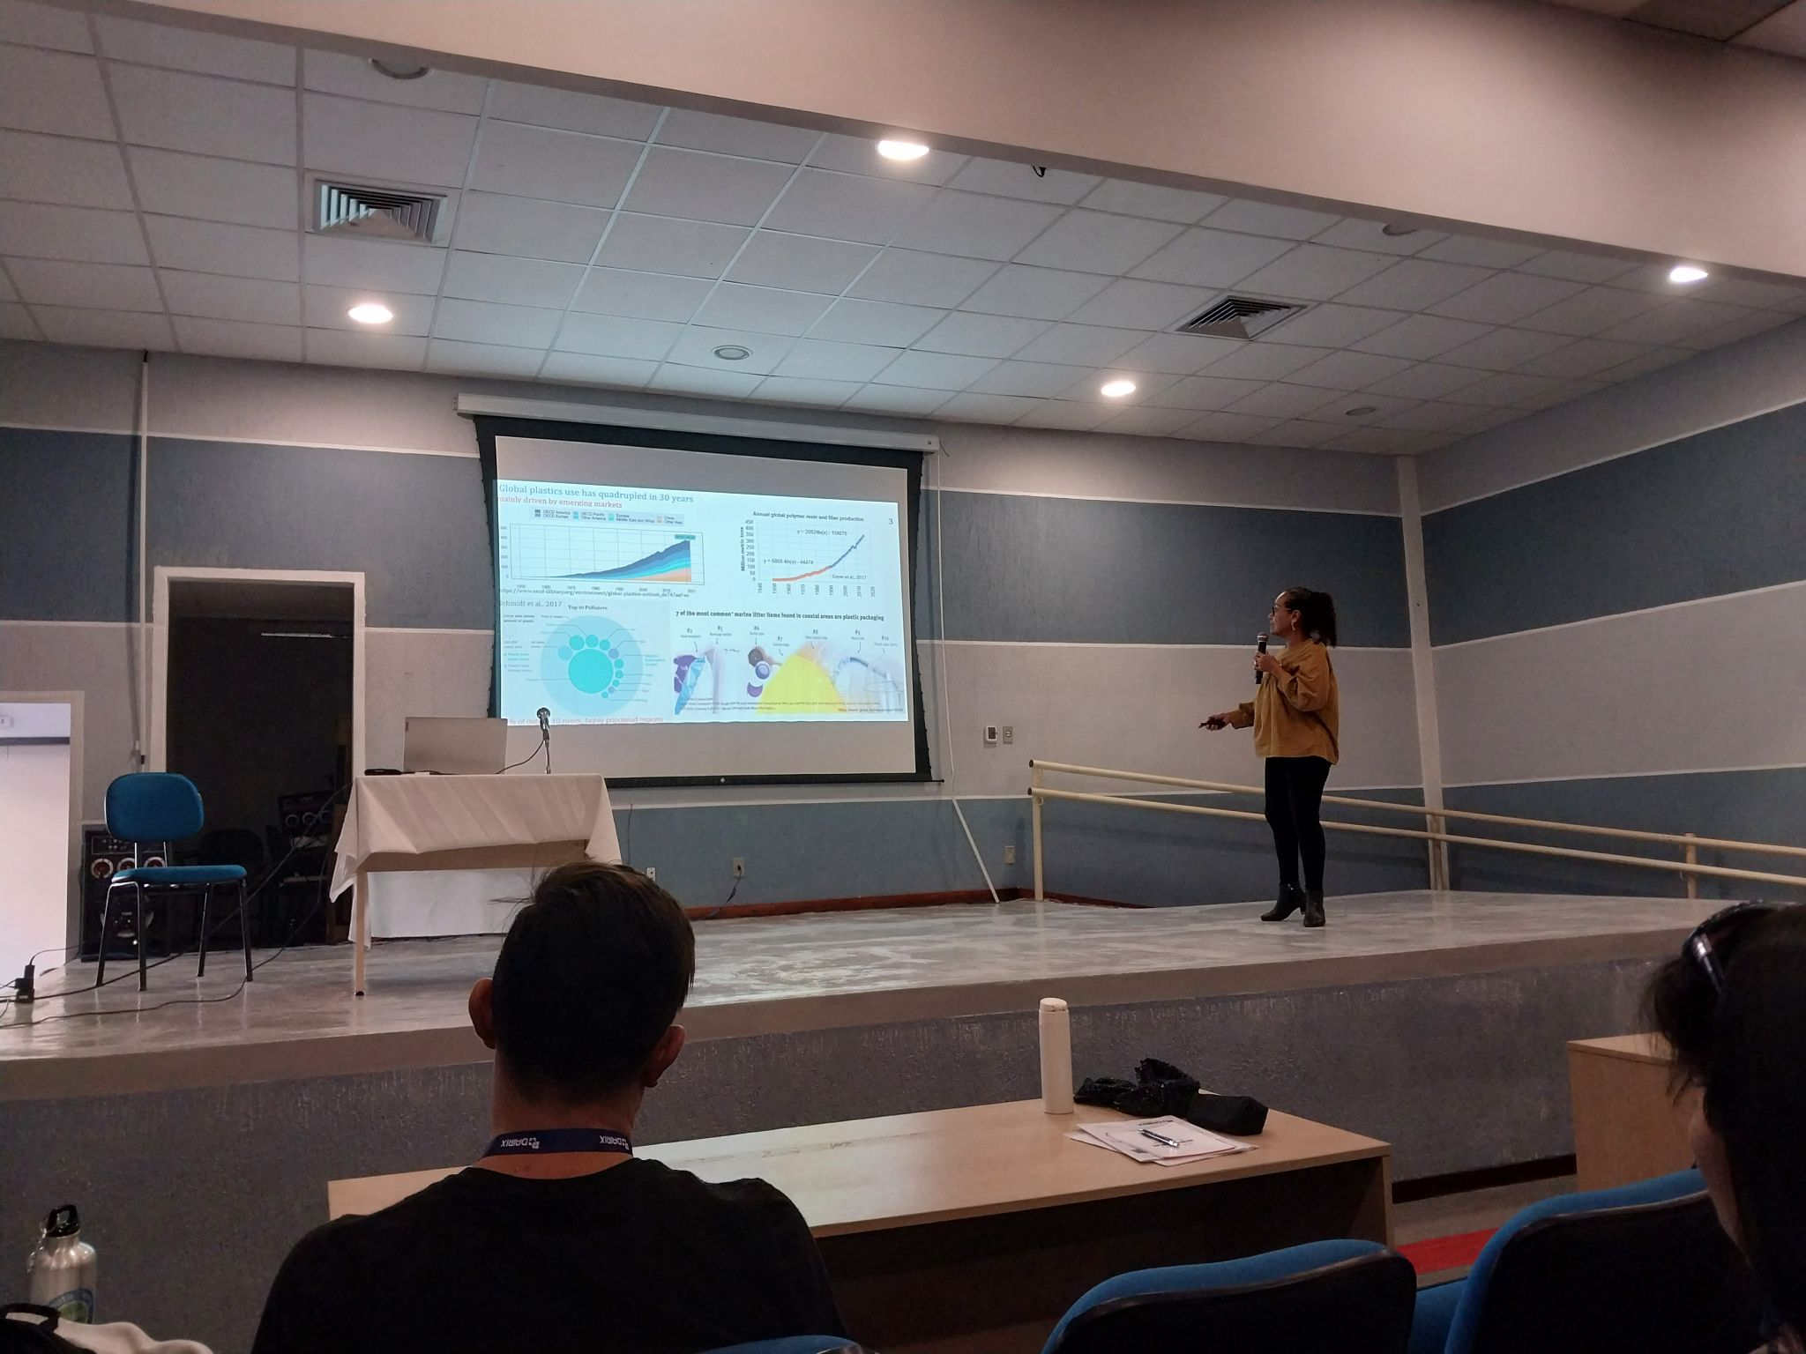
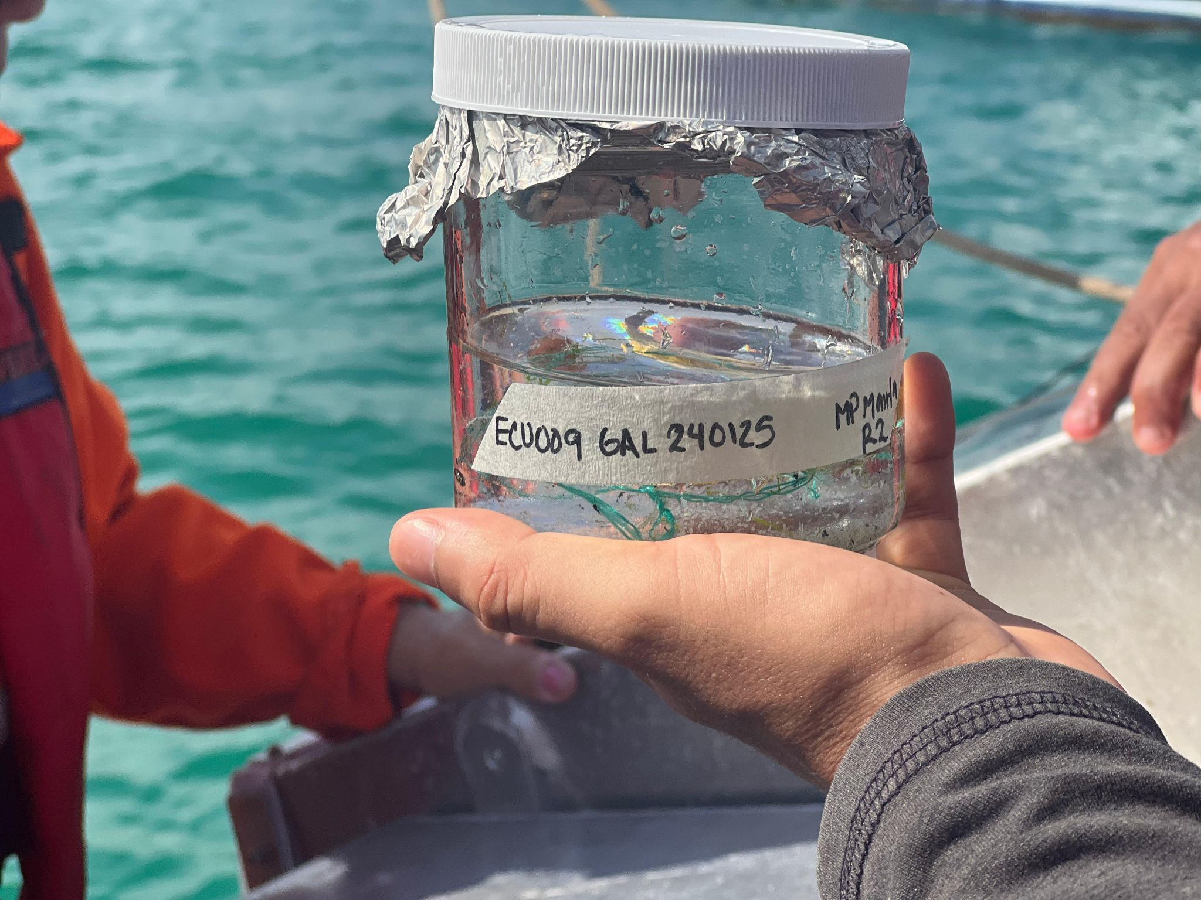
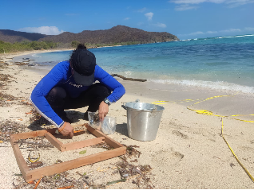
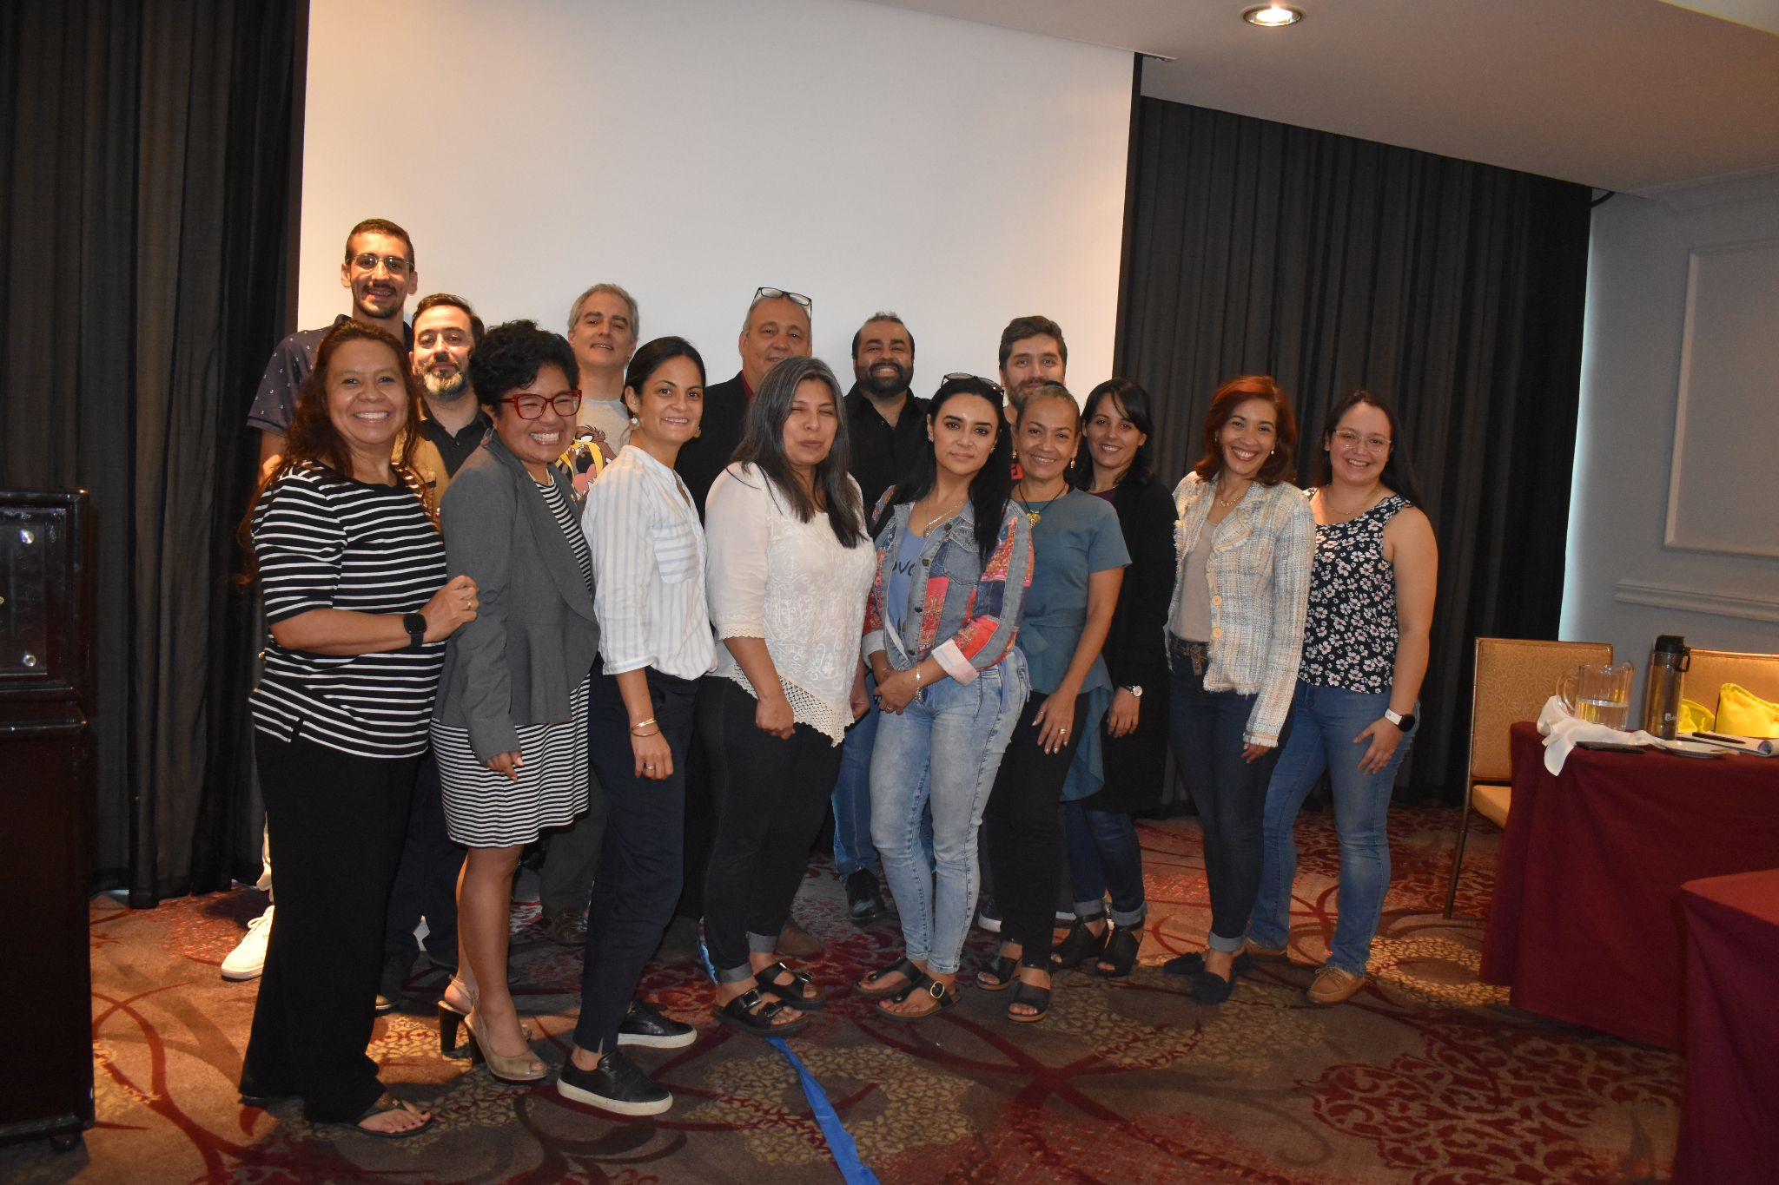


Thanks for your attention
Microplastics component leaders on the REMARCO Executive Committee : Yusmila Helguera, CEAC, Cuba, Mauricio Diaz, CONICET, Argentina
https://remarco.org/contaminacion-por-microplasticos/
#SOMOSREMARCO

Slide 17

Cite as :
Obando-Madera, P.S, Díaz-Jaramillo, M, Saldarriaga-Velez, J.F, Carrasco, D., Helguera, Y., Alonso Hernández, C. (2025). Implementation of a regional network for monitoring microplastics in marine-coastal environments of LAC. REMARCO protocols for monitoring microplastics in beach sand and surface water.. [Power Point presentation]. REMARCO. 16 pp.

